Slide 1
System.Collections
Lightning talk 2017-09-22
By Arnold BARNA

Slide 2
Common methods
All collections provide methods for
adding,
removing or
finding items in the collection
And many more …

Slide 3
A few types
Access by index:
List: basic, versatile
HashSet: only unique elements
Queue: first-in, first-out
Stack: last-in, first-out
Access by key:
Dictionary: key/value pairs

Slide 4
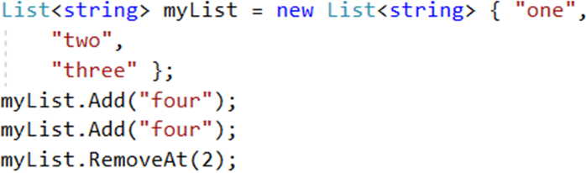
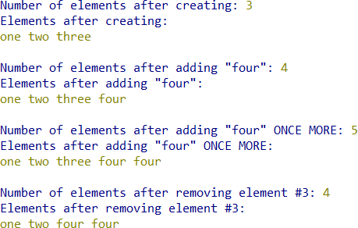
List

Slide 5
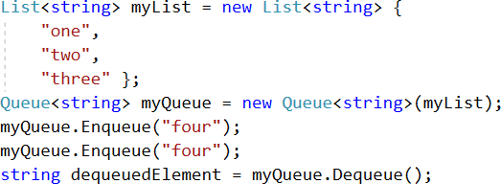
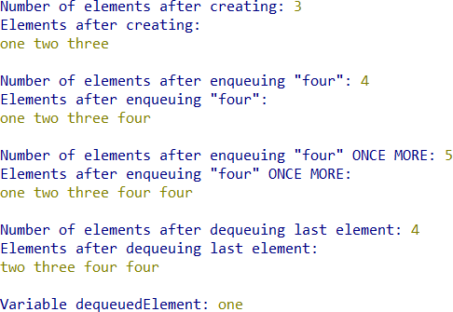
Queue

Slide 6
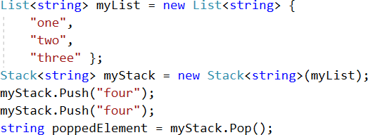
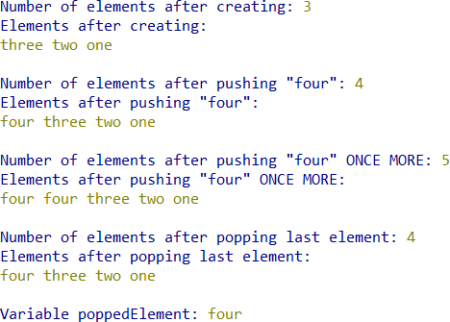
Stack

Slide 7
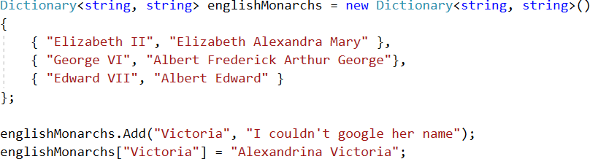
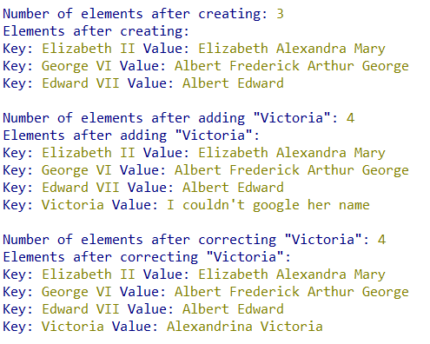
Dictionary

Slide 8
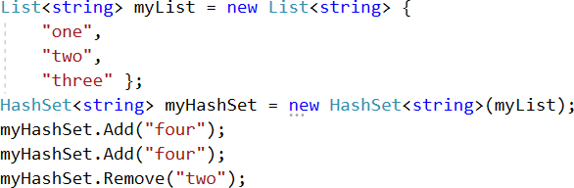
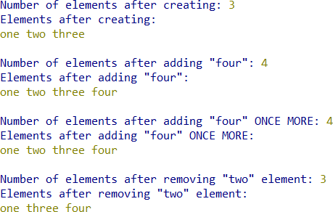
HashSet

Slide 9
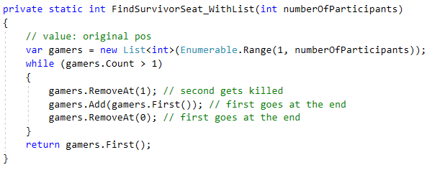
List – Josephus Problem

Slide 10
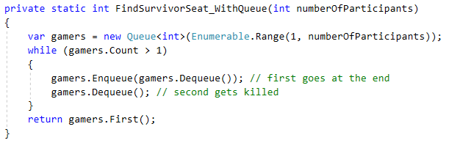
Queue (FIFO) – Josephus Problem

Slide 11
Thank you for the attention
Available on GitHub:
Code:
https://github.com/greenfox-academy/bramble100/tree/master/week-03/lightning-talk
Slides:
https://github.com/greenfox-academy/bramble100/tree/master/week-03/lightning-talk

